Slide 1

Stage 3/Bay 3 Obfuscate It Course Designer: Loke Tan
Obfuscate It is a 30 round, 150 point Comstock Long course. There are 15 USPSA targets. The best 2 hits per target will score. The start signal is audible.
The Handgun start position is standing anywhere. Handgun is loaded and holstered. The PCC start position is standing anywhere PCC loaded, safety on, stock touching belt. All reloading devices to be used on the stage placed on any barrel.
On the audible start signal, engage all targets from within the shooting area.

Slide 2
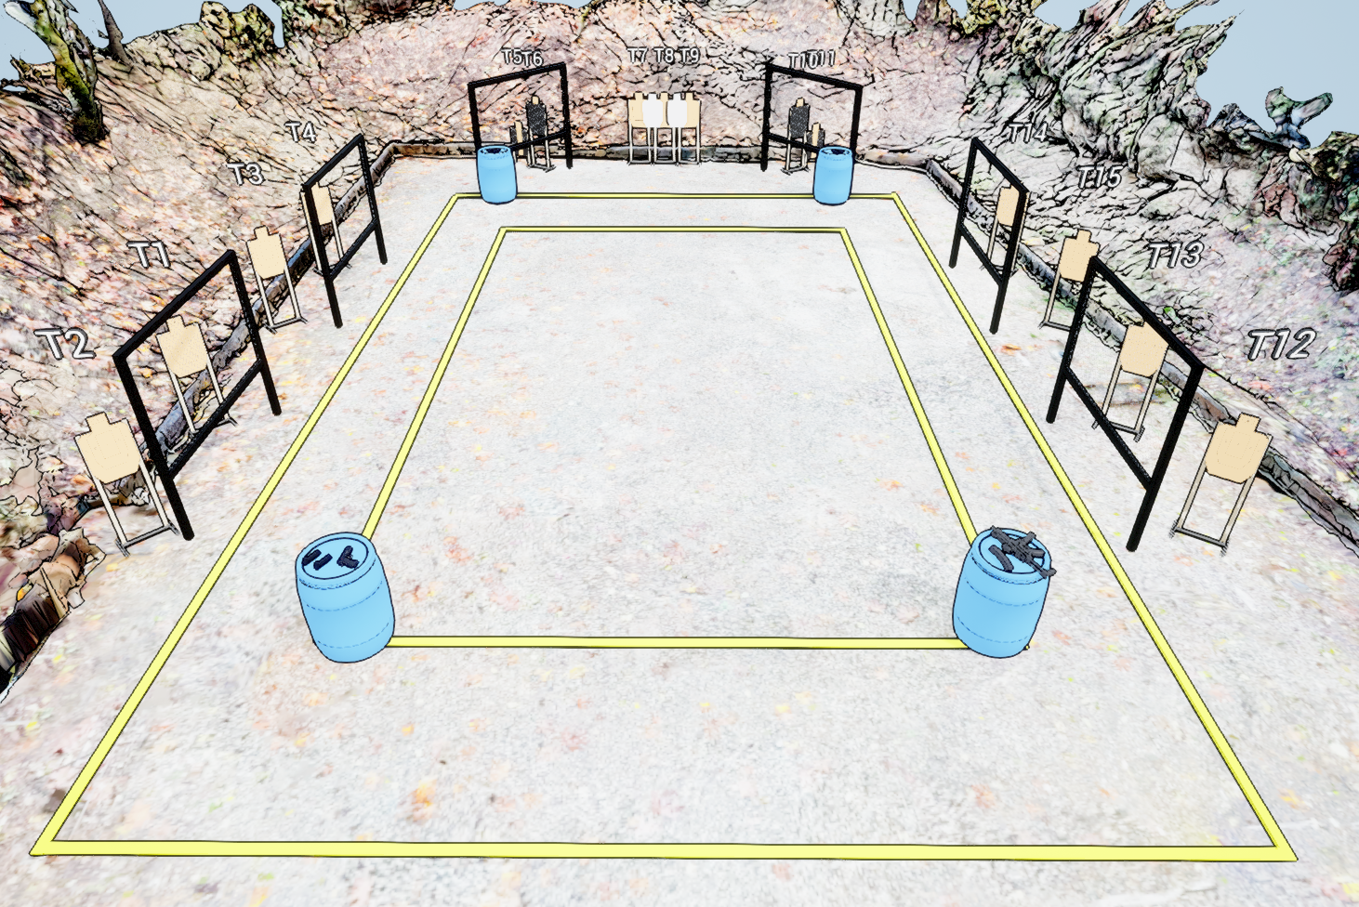
 | Stage 3/ Bay 3 Obfuscate It Course Designer: Loke Tan

